Slide 1
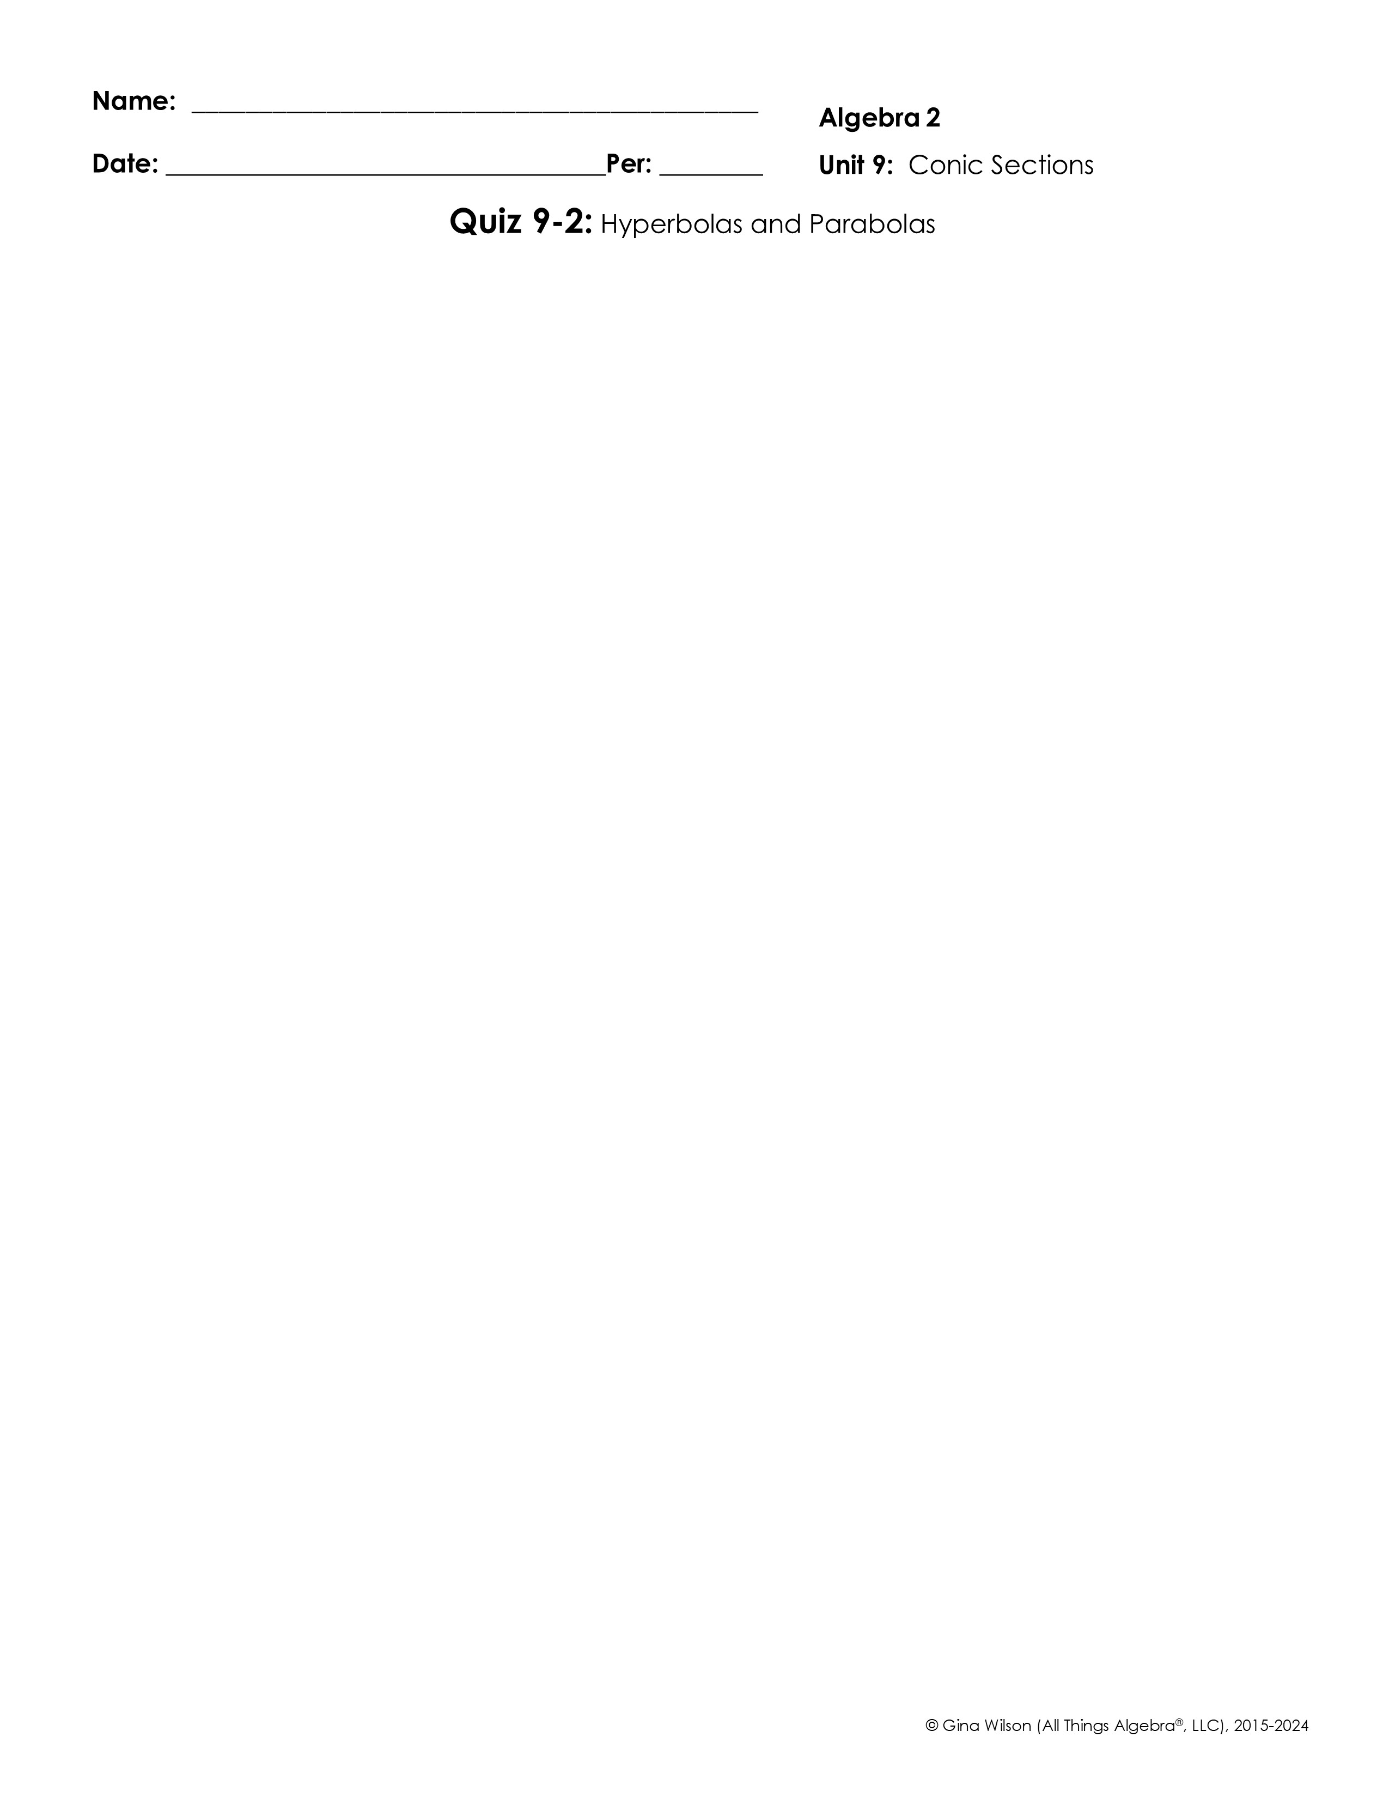
Graph each hyperbola. Identify the center, vertices, co-vertices, foci, and asymptotes.
1.
2.
Center: ________________
Vertices: __________________________________ Co-Vertices: ______________________________ Foci: ______________________________________ Asymptotes: _______________________________ _______________________________
Center: ________________
Vertices: __________________________________ Co-Vertices: ______________________________ Foci: ______________________________________ Asymptotes: _______________________________ _______________________________
3.
Standard Form: _______________________________ Center: ________________
Vertices: _____________________________________ Co-Vertices: _________________________________ Foci: _________________________________________ Asymptotes: __________________________________ __________________________________
Write the equation of the hyperbola in standard form with the given characteristics.
4. Vertices: (-5, 9) and (-5, -11)
Co-Vertices: (2, -1) and (-12, -1)
5. Vertices: (7, 2) and (1, 2) Foci: (9, 2) and (-1, 2)
Standard Form: _______________________________
Standard Form: _______________________________
© Gina Wilson (All Things Algebra®, LLC), 2015-2024

Slide 2

Graph each parabola. Identify the vertex, axis of symmetry, focus, and directrix.
6.
7.
Vertex: ____________
Axis of Sym: ____________
Vertex:
Axis of Sym:
Focus: _____________
Directrix: _______________
Focus:
Directrix:
8.
Standard Form: _______________________________ Vertex: ________________
Axis of Symmetry: ________________ Focus: ________________ Directrix: _______________
Write the equation of the parabola in standard form with the given characteristics.
9. Vertex: (0, 0); Focus: (0, -6)
10. Vertex: (3, -4); Focus: (5, -4)
Standard Form: _______________________________
Standard Form: _______________________________
11. Vertex: (-2, -6); Directrix:
12. Focus: (-5, 2); Directrix: y = 0
Standard Form: _______________________________
Standard Form: _______________________________

